Slide 1
Celebrating National Payroll Week

Slide 2


Slide 3
The Payday candy bar was invented in 1932. At first, the inventors didn’t know what to call their new creation. It happened to be payday, so one of them suggested they call it a Payday bar—and the rest is history!

Slide 4
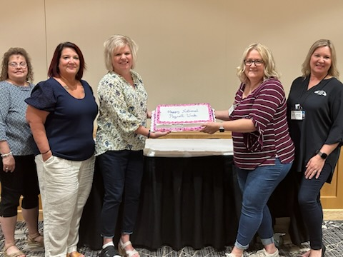

Slide 5
Biweekly payroll is the most common pay frequency in the United States

Slide 6


Slide 7
The first employee time clock was invented by Willard Bundy in 1888

Slide 8


Slide 9
In the 1900’s Henry Ford doubled the wages of employees…If they lived up to his standards at home!

Slide 10


Slide 11
Over 2 million federal employees are paid by the U.S. government, making it the largest payroll system in the world

Slide 12


Slide 13
78.2 million workers in the U.S. are hourly employees. This represents nearly 60 percent of all wage and salary workers.

Slide 14


Slide 15
National Payroll Week was created in 1996

Slide 16


Slide 17
There are only 7 states in The US that do not have Individual Income Tax

Slide 18


Slide 19
the first Federal Minimum Wage Was $.25

Slide 20


Slide 21
The phrase ‘bringing home the bacon’ originated in the early 20th century, used by the working class, with bacon being a staple meat for that class

Slide 22



Slide 23
Don’t want to pay income tax on your earnings? Head over to one of these countries:
-United Arab Emirates
-Hong Kong
-Singapore
-Qatar

Slide 24


Slide 25
Feel like you’re not putting in enough hours at the office? Head over to one of these countries where the work week is 48+ hours.
-Kuwait
-Saudi Arabia
-Bahrain
-United Arab Emirates

Slide 26


Slide 27
Is the commute to work putting a dent in your pocket? Not in Japan! The Japanese receive a commuting allowance that is calculated using the exact commute and route one takes to and from work.

Slide 28


Slide 29
What country has one of the largest Employer Tax Burdens? That would be France, where the employer tax burden is anywhere from 35%-40%.

Slide 30


Slide 31
If it is Christmas time and you need a little extra cash for all of those gifts, then one of these countries is where you should be. The following locations include an extra pay cycle, usually in December to provide extra money for all of those extra expenses:
-Italy
-Mexico
-Belgium

Slide 32


Slide 33
Find yourself debating whether to go to church on Sunday morning? Well, in Germany you can go to service only if you contribute Church Tax (deducted via payroll)

Slide 34


Slide 35
Most countries around the world have 20+ minimum paid vacation days (not including public holidays

Slide 36


Slide 37


Slide 38


Slide 39


